Slide 1
Preparatory Program
Programming Methodologies
Balasubramaniam Kedaranathan
18 Feb 2010
Notes:
1

Slide 2
Software Development Life Cycle
Problem Definition
Problem Analysis
Algorithm Development
Coding and Documentation
Test and Debug
Maintenance

Slide 3
Topic
Programming Methodology
Program Flow
Flowcharts
Pseudo code
Data Storage
Data Structures
Basic Constructs in Programming Languages
Assignment
Control flow constructs
Branching constructs
Functions
Conclusion & work assignment

Slide 4
Programming Methodology

Slide 5
What is a computer program?
Is a sequence of instructions which the CPU interprets as arithmetical and logical operations
Is stored in memory and consists of data and instructions
There is a sequence in which the instructions are carried out in order to complete a given task.
Sequencing of the instructions implies that there is an element of design in a computer program

Slide 6
The generations of computer languages
Figure 1
Human
Oriented
4th Generation Language
Third Generation Language
Problem
Definition
Assembly Language
Machine
Oriented
Machine Code
1940
1950
1960
1970
1980
1990

Slide 7
A Computer program model
Figure 2
Program
Data
Source
Data Sink
The model implies that the program processes data which comes from a source and goes to a destination - the data sink.

Slide 8
Algorithms
Programs = Algorithms + Data
Is an effective procedure for solving a problem in a finite number of steps
An ordered sequence of unambiguous and well-defined instructions that performs some task and halts in finite time
an ordered sequence means that you can number the steps
unambiguous and well-defined instructions means that each instruction is clear, do-able, and can be done without difficulty
performs some task
completes in finite time

Slide 9
Example of an algorithm for making a pot of tea
If the kettle does not contain water then fill the kettle
Plug the kettle into the power point and switch it on.
If the teapot is not empty then empty the teapot.
Place tea leaves in the teapot.
If the water in the kettle is not boiling then go to step 5
Switch the kettle off.
Pour water from the kettle into the teapot.

Slide 10
Key features of algorithms
Sequence or Process
Each step in an algorithm is executed in the specified order
Decision or Selection
The Decision constructs - If ... then, If ... then ... else ...
The outcome of a decision is based on some condition and the result is either TRUE or FALSE
if proposition then process if today is Wednesday then collect pay
if proposition then process1 else process2
Repetition or Iteration or Looping
The Repetition constructs - Repeat and While
Repeat loop or while loop

Slide 11
Repetition or Iteration or Looping
Repeat Process1 Process2 ProcessN Until proposition
The repeat loop does some processing before testing the state of the proposition
Repeat Put water in kettle Until kettle is full
While kettle is not full Put water in kettle

Slide 12
Different ways of stating algorithms
Step-Form
Pseudocode
Flowchart

Slide 13
What is Data ?
Data is a symbolic representation of value and programs set the context which gives data meaning - in programs data is transformed into information.
How is data represented in programs?
Variables
The data is "contained" in a thing called a variable. The variable is a container for a value which may vary during the execution of the program.

Slide 14
Variables - Example
Each variable in a program is given a name.
Water_Level
Water_Temperature
Tea_Leaves_Quantity
If the kettle does not contain water then fill the kettle
could also be written as:
If Water_Level is 0 then fill the kettle
or
If Water_Level = 0 then fill the kettle

Slide 15
Naming of variables
You should always try choose meaningful names for variables in algorithms to improve the readability of the algorithm or program. This is particularly important in large and complex programs.

Slide 16
Algorithm - Step form
Problem Definition: Count the number of vowels in a page
Set current_letter_position to 1
Set last_letter_position to number of letters on the page
Set vowel_counter to 0
Read letter at current_letter_position
If letter is a vowel then increment vowel_counter
Increment current_letter_position
If current_letter_position <= last_letter_position go to step 4

Slide 17
Pseudocode
Pseudo code is a written statement of an algorithm using a restricted and well-defined vocabulary.
Pseudo code is a kind of structured English for describing algorithms
It allows the designer to focus on the logic of the algorithm without being distracted by details of language syntax
At the same time, the pseudo code needs to be complete
\It describes the entire logic of the algorithm so that implementation becomes a mechanical task of translating line by line into source code

Slide 18
Pseudocode Contd …
The major differences between this lesson and the previous are:
You use pseudo code instead of step-form
The arithmetic, relational and logical operators are introduced
The notion of the sub-process is introduced
You learn a little bit more about iteration

Slide 19
Input, output, iteration, decision and processing in pseudo code

Slide 20
Group - Input/Output
Key words
INPUT, READ - Used to get values from a data source, a keyboard for instance
DISPLAY - Used to output values to a data sink, a screen or printer for instance
Example
INPUT counter
DISPLAY new_value

Slide 21
Group - Iteration
Key words
REPEAT statement UNTIL <condition>
The REPEAT loop executes the statement until the <condition> becomes true. Example
SET count_value TO 0 REPEAT DISPLAY count_value ADD 1 TO count_value; UNTIL count_value > 10

Slide 22
Group - Iteration
Key words
DOWHILE <condition> statement END DOWHILE
The WHILE loop executes the statement while the <condition> is true.
Example
DOWHILE count_value < 10 DISPLAY count_value count_value = count_value + 1 END DOWHILE

Slide 23
Group - Iteration
Key words
FOR <var> = <start value> to <stop value> ENDFOR
This is a special case of the While loop. The FOR loop iterates for a fixed number of steps. The While and Repeat loops can be for a variable number of steps.
Example
FOR count = 1 to 10 DISPLAY count + count ENDFOR

Slide 24
Group - Decision
Key words
IF <condition> THEN statement ENDIF
IF <condition> THEN statement ELSE statement ENDIF
Example
IF count > 10 THEN DISPLAY count ENDIF
IF count > 10 THEN DISPLAY 'count > 10' ADD 4 to sum ELSE DISPLAY 'count <= 10' ADD 3 to sum ENDIF

Slide 25
Group - Processing
Key words
ADD, SUBTRACT, COMPUTE, SET
Example
ADD 3 TO count SUBTRACT 5 FROM count SET count TO 12 COMPUTE 10 + count GIVING new_count

Slide 26
Nested Constructs
Example
SET total to zero REPEAT
READ Temperature IF Temperature > Freezing THEN INCREMENT total END IF
UNTIL Temperature < zero Print total
In the above example, the IF construct is nested within the REPEAT construct, and therefore is indented.

Slide 27
Nested Constructs Contd …
Example – Repeat Nested loop
st_count = 0 total_fee = 0 REPEAT INPUT student_name subject_count = 0 REPEAT INPUT subject_title INPUT subject_cost total_fee = total_fee + subject_cost subject_count = subject_count + 1 UNTIL subject_count = 4 st_count = st_count + 1 UNTIL st_count = 100

Slide 28
Nested Constructs Contd …
Example – While Nested loop
st_count = 0 total_fee = 0 DOWHILE st_count < 100 INPUT student_name subject_count = 0 DOWHILE subject_count < 4 INPUT subject_title INPUT subject_cost total_fee = total_fee + subject_cost subject_count = subject_count + 1 END DOWHILE st_count = st_count + 1 END DOWHILE

Slide 29
Flow chart
A flowchart illustrates the steps in a process
By visualizing the process, a flowchart can quickly help identify bottlenecks or inefficiencies where the process can be streamlined or improved
BASIC FLOWCHARTING SHAPES AND SYMBOLS
Flowcharts use special shapes to represent different types of actions or steps in a process. Lines and arrows show the sequence of the steps, and the relationships among them.
Start/End The terminator symbol marks the starting or ending point of the system. It usually contains the word "Start" or "End."

Slide 30
Action or Process A box can represent a single step ("add two cups of flour"), or and entire sub-process ("make bread") within a larger process
Decision A decision or branching point. Lines representing different decisions emerge from different points of the diamond.
Input/Output Represents material or information entering or leaving the system, such as customer order (input) or a product (output)

Slide 31
Document A printed document or report
Connector
Subroutine Indicates a sequence of actions that perform a specific task embedded within a larger process. This sequence of actions could be described in more detail on a separate flowchart.

Slide 32
While Loop
Decision
False
True
Sequence

Slide 33
Repeat Loop
Sequence
Decision
False
True

Slide 34
IF … Then
False
Decision
True
Sequence

Slide 35
IF … Then … ELSE
False
Decision
True
Process 2
Process 1

Slide 36
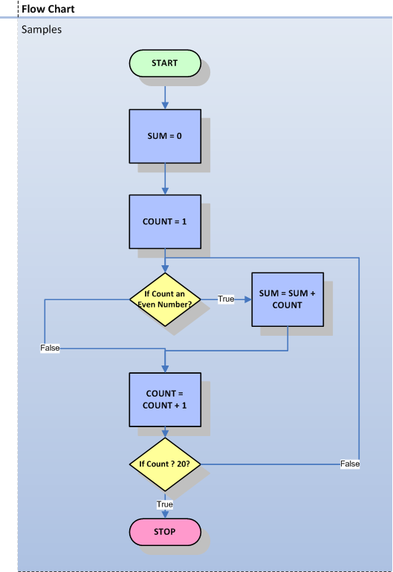
Flowcharts to Design Programs

Slide 37
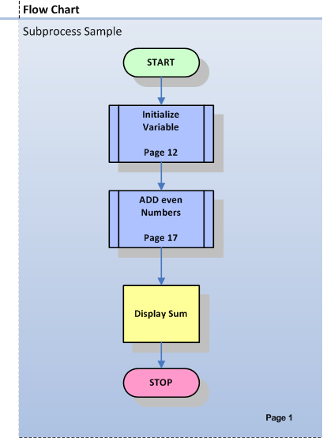
Flowchart with Subprocess

Slide 38
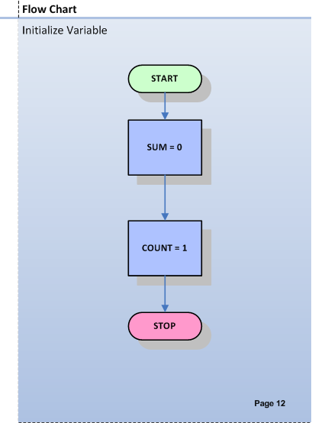
Subprocess – Initialize variables

Slide 39
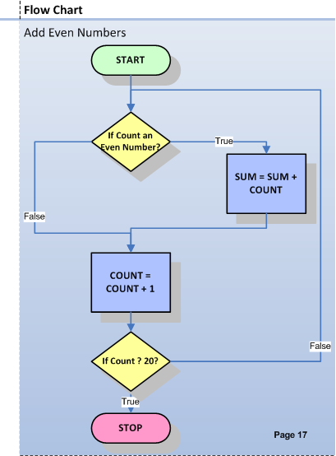
Example – To add even numbers

Slide 40
Thank You

